Slide 1
How to Write a DML Trigger
Louis Davidson
drsql.org

Slide 2
Initial Warning
Triggers and Tiggers have one important thing in common
Generally speaking, you are better off the fewer of them you need around

Slide 3
Agenda
Introduction
Designing a Trigger Solution
Trigger Coding Basics
Advanced Trigger Concepts
Summary

Slide 4
Introduction
A basic introduction to trigger concepts

Slide 5
What are Triggers?
Coded modules that are very similar to stored procedures
Cannot be called directly
“Triggered” by certain events
With “special” tables/tools to access event data
Types:
DML –Table/View level, fire on INSERT, UPDATE and/or DELETE to a single object (our focus today)
DDL – Server or Database level, fire whenever a DDL statement is executed
Login – Fire whenever a user logs into the server
Triggers existed in Microsoft SQL Server 1.0 (far before check constraints!)

Slide 6
DML Trigger Execution details
Execute once per DML statement
Access the current state using INSERTED virtual object, removed via DELETED
Should not seen and not heard
Don’t return results from triggers
2005-Later has “disallow results from triggers” server configuration
Ability to do so will be removed in an upcoming SQL Server version
Caveat: returning results can be effective for debugging
Execute as part of the operation statement
ROLLBACK in the trigger will stop the operation (and anything else that is part of the current transaction)
Can use EXECUTE AS to elevate the permissions of the trigger code similar to stored procedures
Only in extreme circumstances!

Slide 7
DML Triggers – Two types
INSTEAD OF – When an INSERT, UPDATE or DELETE occurs, instead of the typical code executed, the trigger executes instead. You have to code the effective INSERT, UPDATE or DELETE .
AFTER – When an INSERT, UPDATE or DELETE occurs, the typical operation occurs, and then the coded object executes.
The use cases for each are different, which we will cover in a bit more detail later

Slide 8
Multiple Triggers
INSTEAD OF - Each table can have only 1 for each of the operations (Maximum of 3, for INSERT, UPDATE, DELETE)
AFTER
You can have any number of after triggers
You can minimally control the first and last trigger for an operation using sp_settriggerorder
Caution: Again, more triggers is not necessarily more better
There is a demo of multiple triggers and ordering in the downloads for the session

Slide 9
This session is not entitled: How to Write DML Triggers Instead of Using Proper Implementation Techniques for a reason…

Slide 10
Triggers are…
Harder to get right than normal DDL solutions
Slower to operate than normal DDL solutions
Harder to support than normal DDL solutions
Sometimes all we have to work with and then very very useful

Slide 11
What do customers care about?
Top Issue with Database Implementations:
#1 Data Quality
#2 Performance (But doesn’t matter if the data quality stinks)
#2 Usability (But still doesn’t matter if the data quality stinks)
#4 Doesn’t matter if the data quality stinks
#5 Really doesn’t matter if the data quality stinks
Anything we can do to protect the quality of the data worth the effort (and COST)
Every tool we have in SQL Server for data integrity has at least some use

Slide 12
Data Protection 1/3 – Begin right
Get the structures correct
Normalization -Normalized structures are far less susceptible to data integrity issues
Datatypes choice
Match datatypes to the needs of the user
Data stored in the right datatype works better for the Query Processor
Make sure only the right people are modifying structures

Slide 13
Data Protection 2/3 - Constraints
Make full use of SQL Server constraints to protect the data structures
NULL: Determines if a column will accept NULL for its value. NULL constraints aren’t technically constraint objects, but they behave like them.
PRIMARY KEY and UNIQUE: Used to make sure your rows contain only unique combinations of values over a given set of key columns.
FOREIGN KEY: Used to make sure that any migrated keys have only valid values that match the key columns they reference.
CHECK: Used to limit the values that can be entered into a single column or an entire row.
DEFAULT: Used to set an acceptable default value for a column when the user doesn’t provide one. (Some people don’t count defaults as constraints, because they don’t constrain updates.)
Some of this will not help performance, some will harm it. But see the Introduction slide for what matters most

Slide 14
Data Protection 3/3
Determine what can be reliably done using client code
Stored procedures
Compiled, procedural code
The key word in previous bullet: “reliably”
Client code is notoriously untrustworthy due to concurrency requirements
Often multiple layers implementing the same rules can be useful
Consider all channels that data can arrive from
Triggers can assist in filling gaps that can not be handled reliably in any other manner

Slide 15
Trigger Coding Basics
What makes triggers different from stored procedures

Slide 16
Basics To Cover
The basic working bits of a trigger (and a template to make it easier)
There are several parts of a DML trigger that exist 99% of the time (rowcount, try catch, etc)
The template presented is my coding trigger template, used to introduce the set up of the trigger
Accessing modified data via the INSERTED and DELETED virtual tables
Understanding multi-row operations
Determining Referenced Columns in DML Statement
Error Handling
A set of demo code will be used to show these points

Slide 17
Core trigger coded operations
Validating modified data
Simple – Look for any bad row if exists ( <returns data only for bad data>) THROW 50000, N'bad data exists',1;
Complex – Make sure all rows meet (multiple) criteria declare @rowcount1 = (select count(*)…) declare @rowcount2 = (select count(*)…) if @rowsAffected <> @rowcount1 + @rowcount2 THROW 50000, N'try again!',1;
Modifications – Basically just executing a DML statement

Slide 18
Trigger Nesting/Recursion
When you execute a DML statement in a trigger, by default (and the most typical setting)
The trigger will not recurse (INSERT trigger on table A inserts a row into table A will not cause the trigger to refire)
The trigger will nest (INSERT trigger on table A updates a row in table A and inserts a row into table B would cause an update trigger on table A and an INSERT trigger on table B to fire if they existed)
Two settings affect these settings (with the default values)
exec sp_configure 'nested triggers',1;
alter database <DatabaseName> set recursive_triggers off;
There is a demo of changing this behavior in the downloads. These settings are dangerous because they can change behavior without changing code!

Slide 19
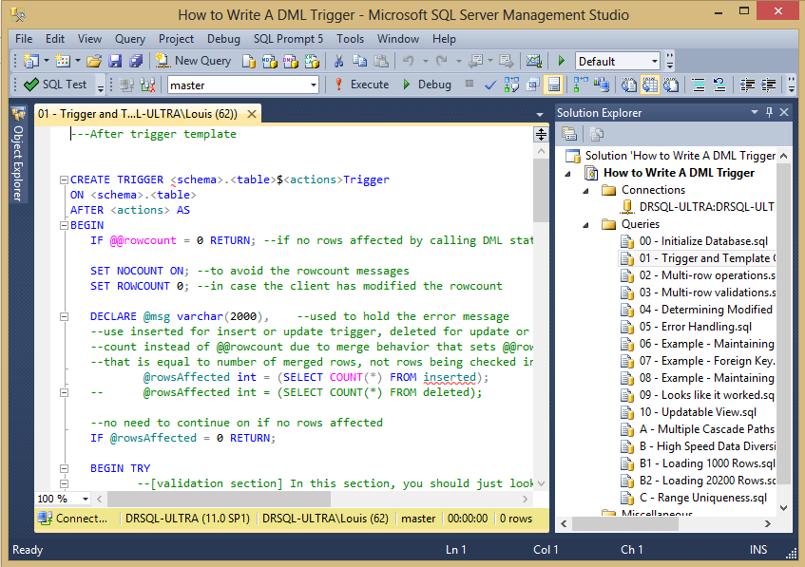
Trigger Coding Basics (Demo)
Demonstrating the essential trigger coding techniques…

Slide 20
Designing a Trigger
Making sure you understand what needs to be handled by the trigger before you start coding.

Slide 21
Designing a Trigger
When using constraints, there will always be a single object needed to do the entire job
Check Constraint
Foreign Key
When building a trigger, you have to cover:
All tables that are involved with the process
All operations that might be involved
INSERT
UPDATE
DELETE

Slide 22
Choosing the type of trigger to use – AFTER
Typically used for validation and non-destructive cascading operations
Allow you to check the effects of the DML statement
You can see the state of database after the operation
Examples – Included as sample code
Inter-row/Inter-table Data validations, such as foreign keys/range overlapping, where constraints will not work
Summary data (where heavily tested and determined to be necessary)

Slide 23
Choosing the type of trigger to use – INSTEAD OF
Typically used to change the operation in some manner, either lightly or dramatically
Also for cascade operations to avoid RI errors, like a cascade delete
Examples - Included as sample code
Overriding format of data (formatting input, overriding user input, such as a date and time)
Ignoring/logging for review “bad” data (high speed data entry, instrument data)
Making multi-table views updatable using simple T-SQL

Slide 24
Scenario Introduction
Today, we will start with 3 basic scenarios for the first half of the demos
Maintaining a row inserted and updated time on a row that no one can override
Preventing a negative balance
Foreign key that spans databases
Note: useful only in rare cases, typically involving third party databases, but illustrates the complexities in a problem that everyone has

Slide 25
Maintaining a row inserted and updated time on a row
Table Involved
Table1 (Table1Key, RowCreatedTime, RowLastModifyTime)
Row Inserted
Row Updated
Row Deleted
Type of triggers:
INSTEAD OF

Slide 26
Preventing a Negative Balance
Tables Involved
Parent Table (ParentId, ChildValueSum (not stored)) | Child Table (ChildId, ParentId FK, Value)
Row Inserted | Row Inserted
Row Updated | Row Updated
Row Deleted | Row Deleted
Type of triggers:
AFTER

Slide 27
A Foreign Key That Spans Databases
Tables Involved
ParentTable (ParentTableId) | ChildTable (ChildTableId, ParentTableId "FK")
Row Inserted | Row Inserted
Row Updated | Row Updated
Row Deleted | Row Deleted
Type of triggers:
AFTER

Slide 28
Trigger Design and Coding Scenarios
A code review on the triggers…

Slide 29
Maintaining a row inserted and updated time on a row
Table Involved
Table1 (Table1Key, RowCreatedTime, RowLastModifiedTime)
Row Inserted
Row Updated
Row Deleted
Type of triggers:
INSTEAD OF

Slide 30
Preventing a Negative Balance
Tables Involved
Parent Table (ParentId, ChildValueSum (not stored)) | Child Table (ChildId, ParentId, Value)
Row Inserted | Row Inserted at Child
Row Updated | Row Updated at Child
Row Deleted | Row Deleted From Child
Type of triggers:
AFTER

Slide 31
A Foreign Key That Spans Databases
Tables Involved
ParentTable (ParentTableId) | ChildTable (ChildTableId, ParentTableId "FK")
Row Inserted | Row Inserted at Child
Row Updated | Row Updated at Child
Row Deleted | Row Deleted from Child
Type of triggers:
AFTER

Slide 32
Advanced Topics
Settings and metadata to fully understand trigger operation
Note: This section may not be achievable in a 60 minute session but will be available to download with examples

Slide 33
Advanced Topics To Cover (Demos)
Getting trigger metadata - queries
Multiple triggers of the same type on the same table and ordering
Trigger Nesting/Recursion
System Settings - can change trigger execution without changing code
sp_serveroption— nested triggers (default ON)– Determines if a DML statement from one trigger causes other DML triggers to be executed
database option—RECURSIVE_TRIGGERS (default OFF)– Determines if an update on the table where the trigger fired causes the same triggers to fire again
sp_serveroption–disallow results from triggers (default OFF): Turn this setting on will ensure that any trigger that tries to return data to the client will get an error
sp_serveroption-server trigger recursion (default ON) – Determines if DDL in a server DDL trigger causes it to fire again

Slide 34
Advanced Topics (Demo)
Coded examples showing some advanced trigger concerns

Slide 35
Summary
Triggers are equal parts friend and foe

